Slide 2
Agenda
1 Opening
2 Achievements & Projects
3 Learning & Growth
4 Challenges & Overcoming
5 Better version of myself

Slide 3
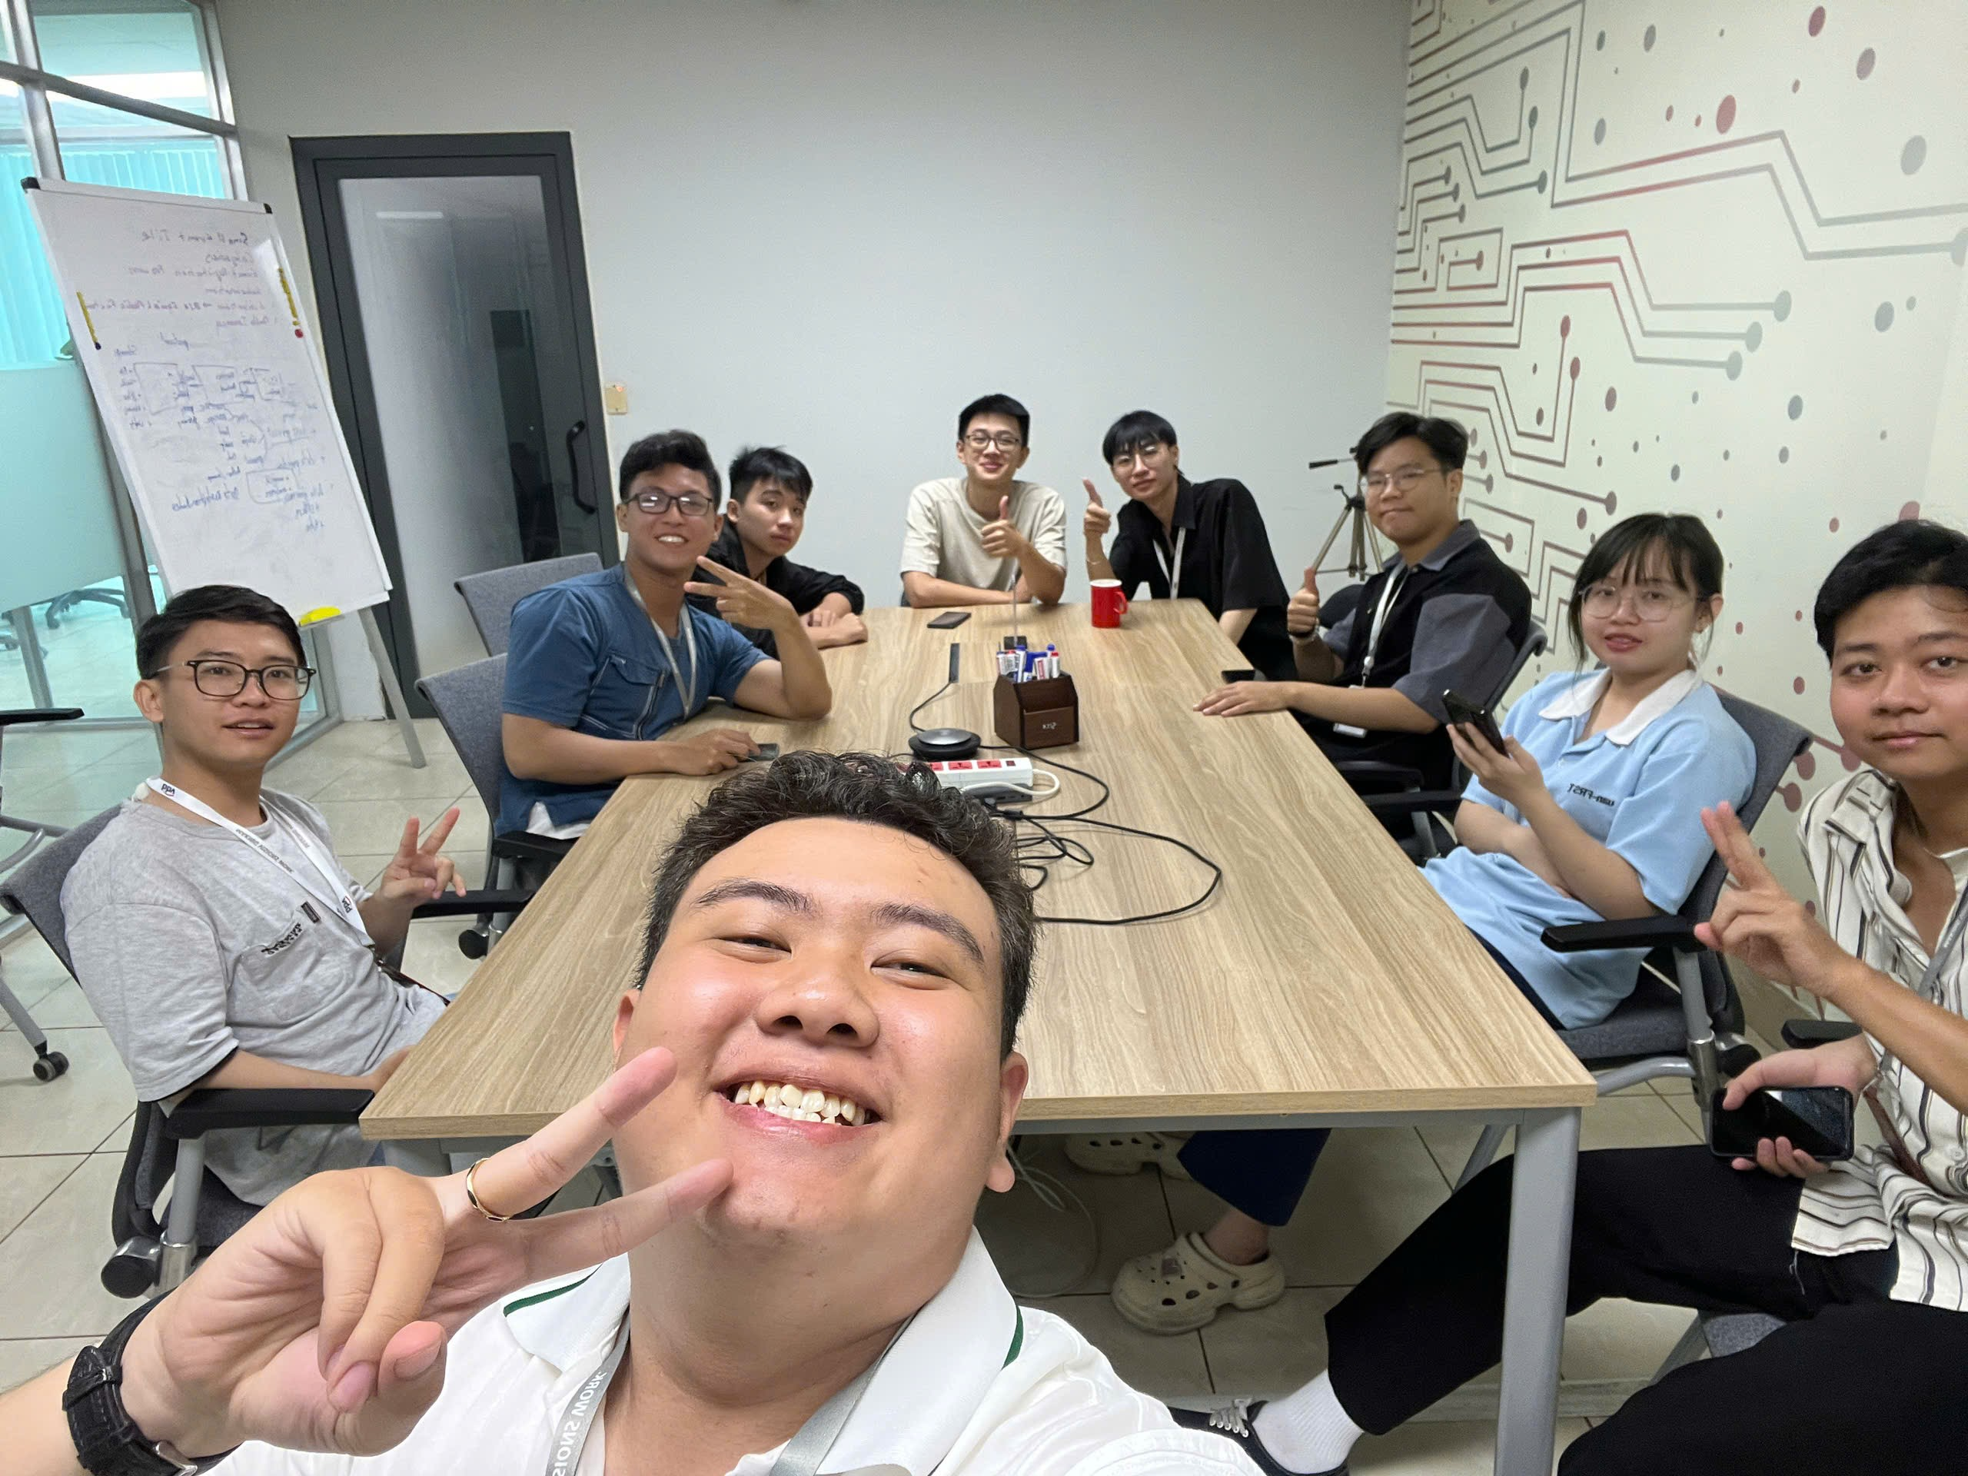
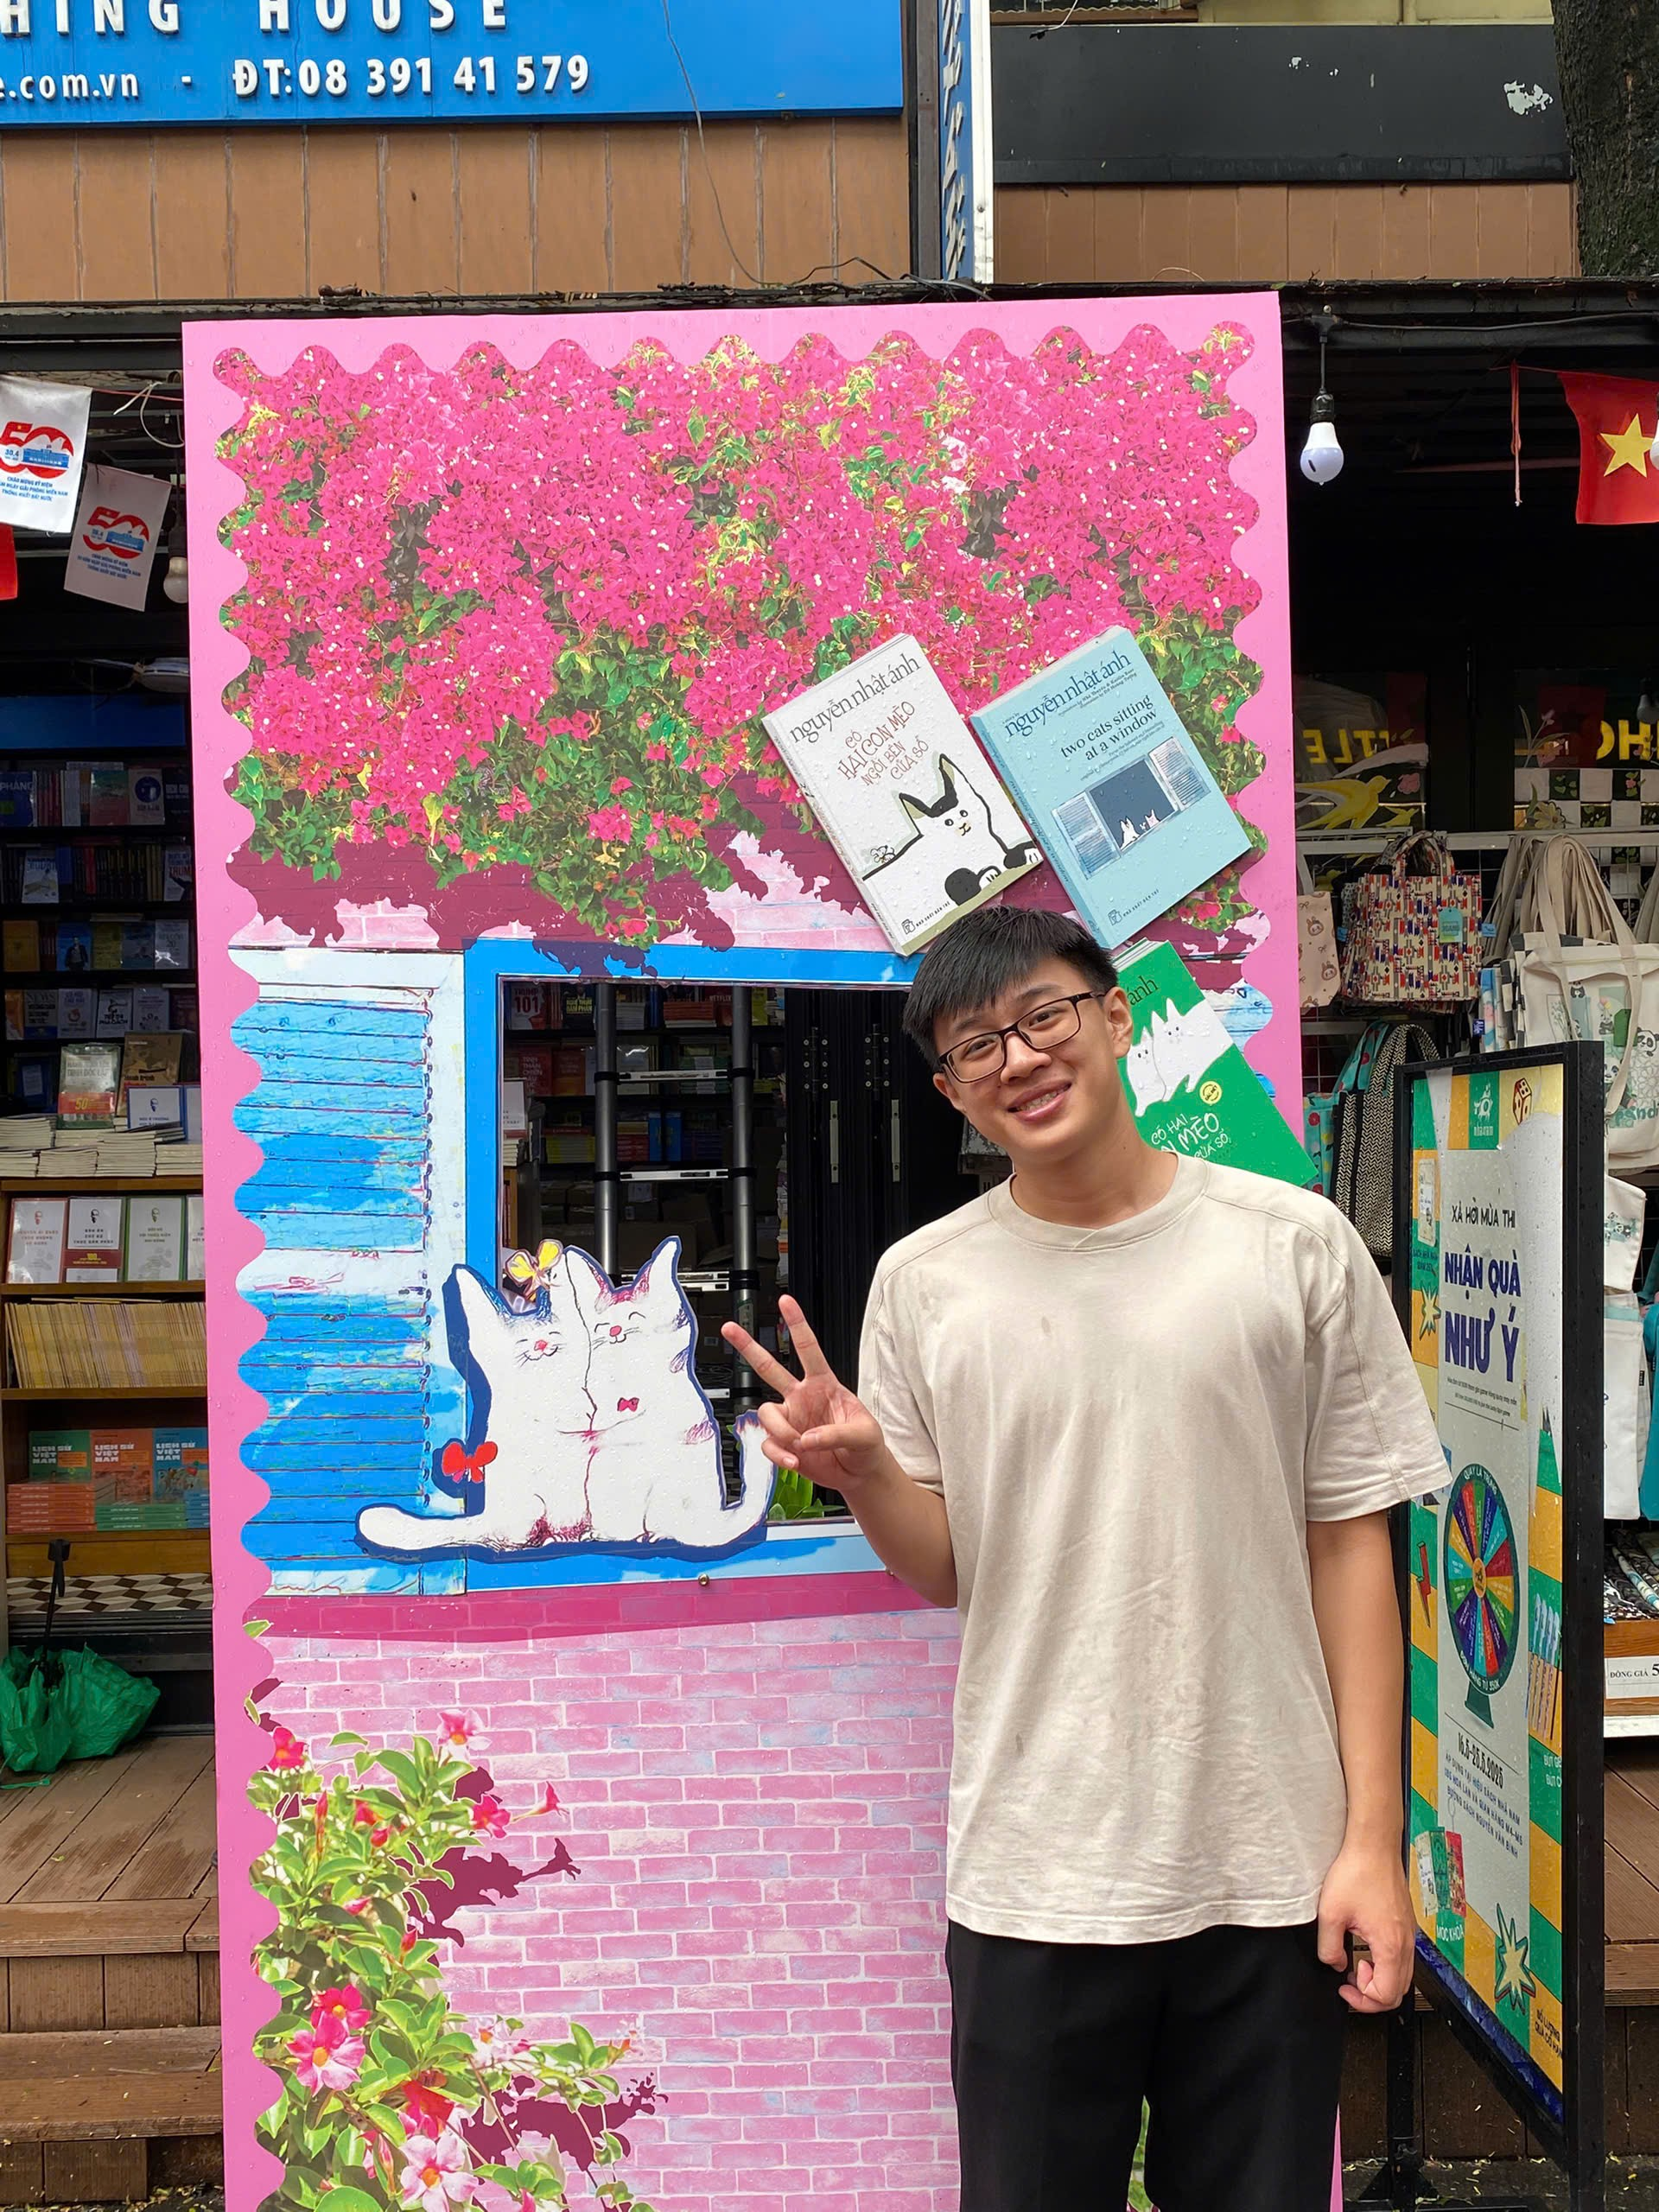
YPP4 – TEAM

Slide 4
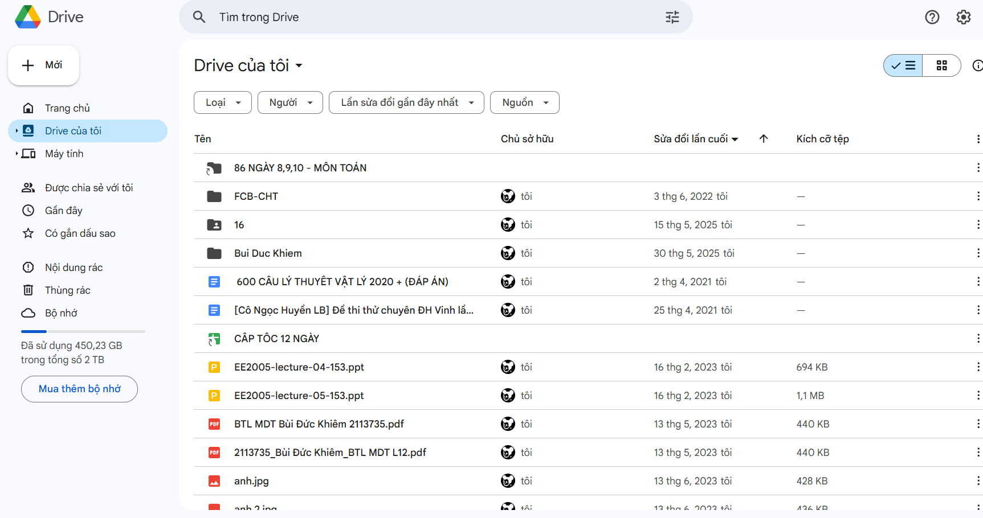
Analysis Requirement

Slide 5
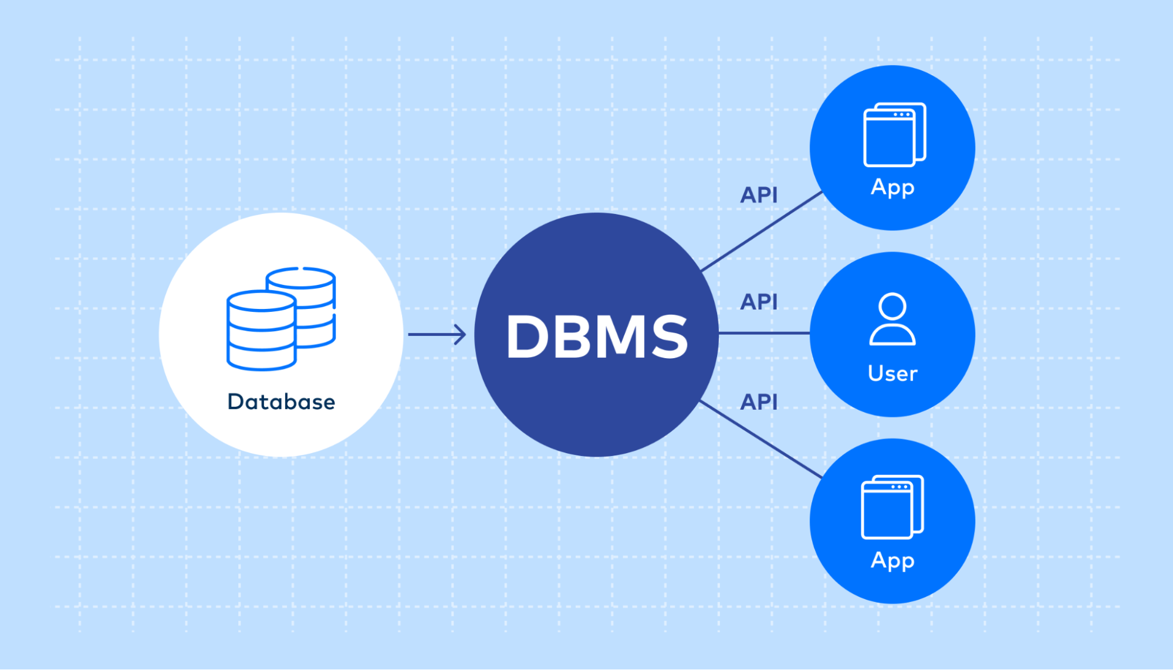
Database

Slide 6


Programming

Slide 7

Test case

Slide 8
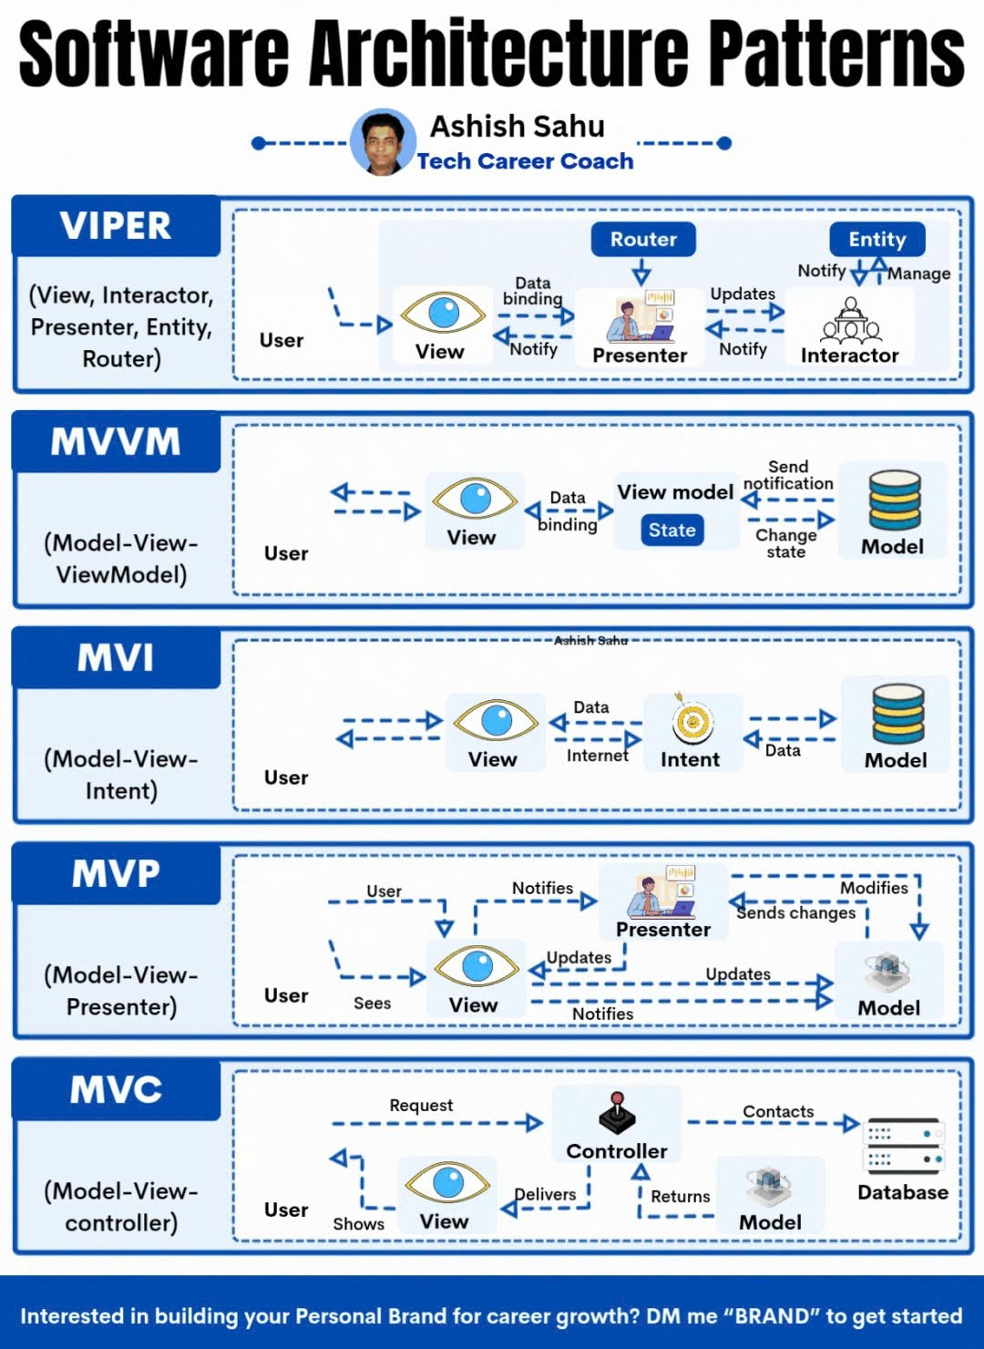
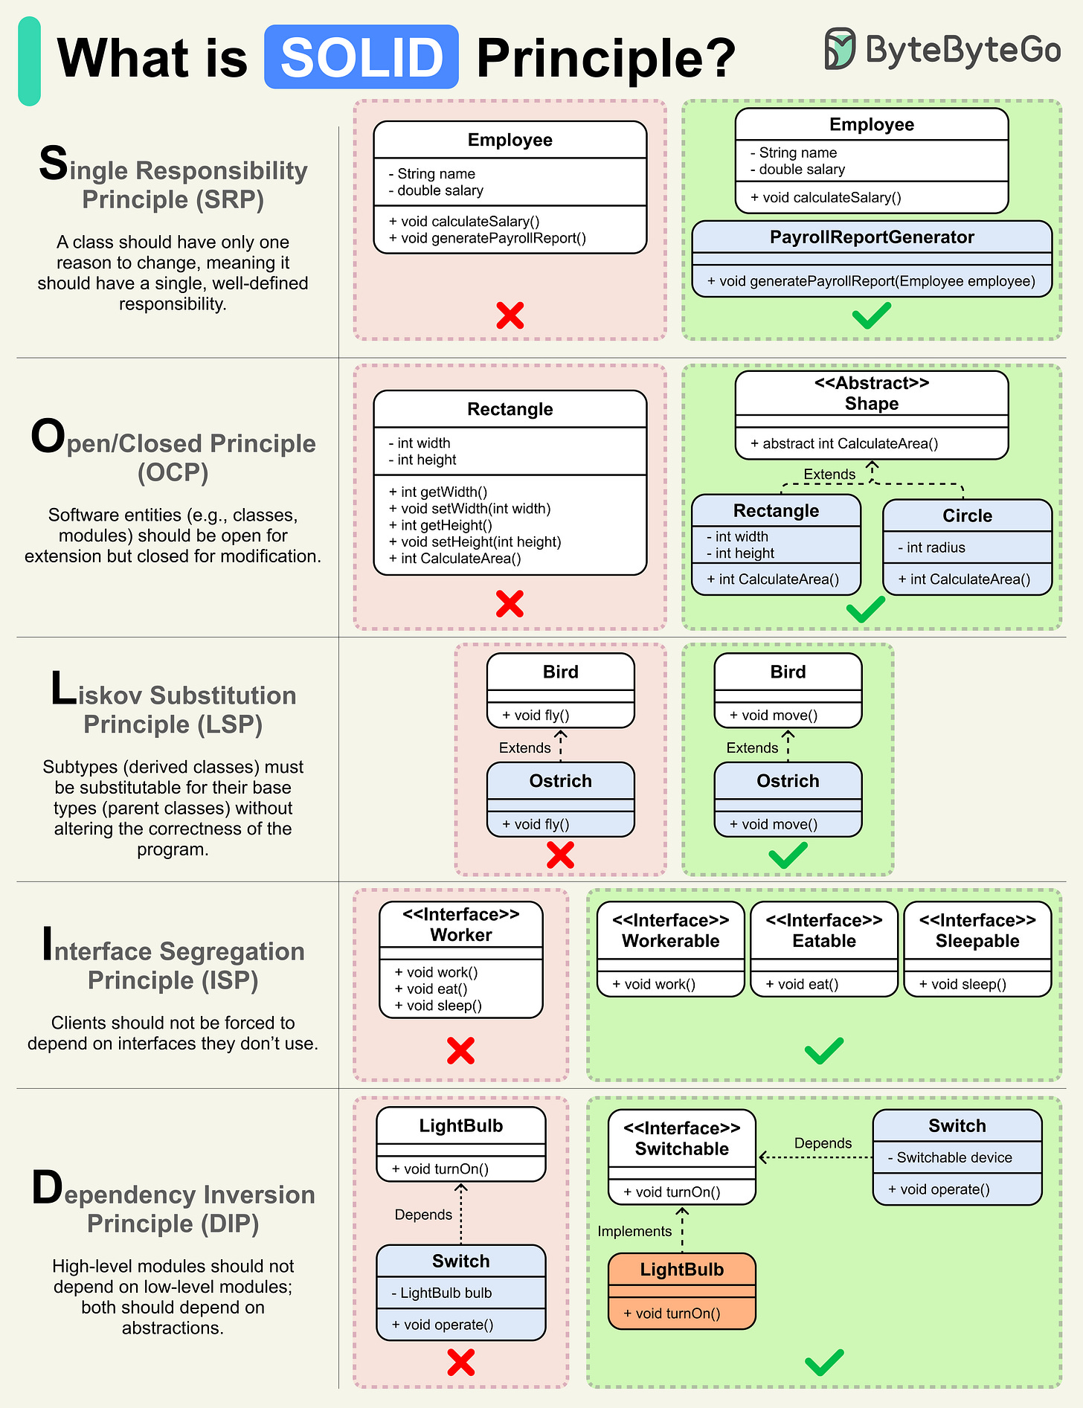
Principles

Slide 9




Tool , Framework

Slide 10

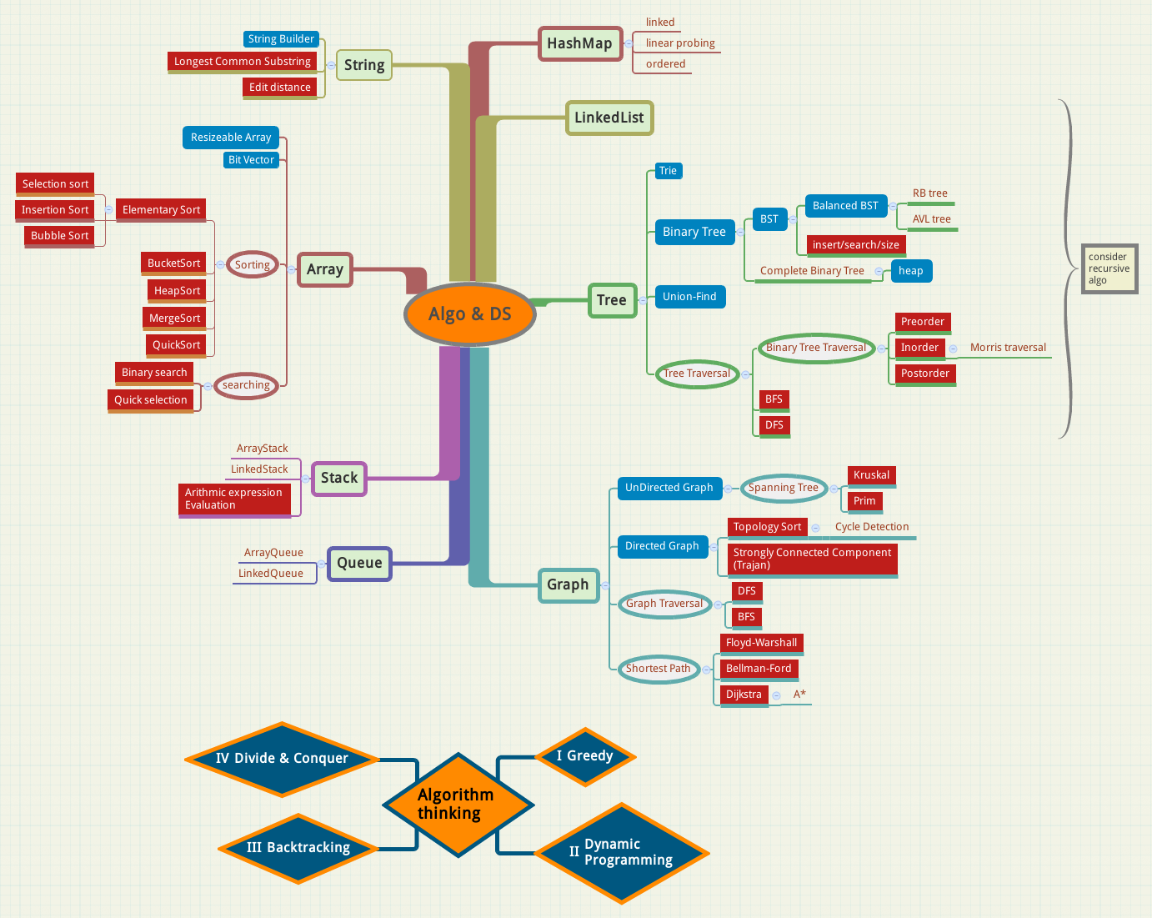
Programming

Slide 11


Career

Slide 12
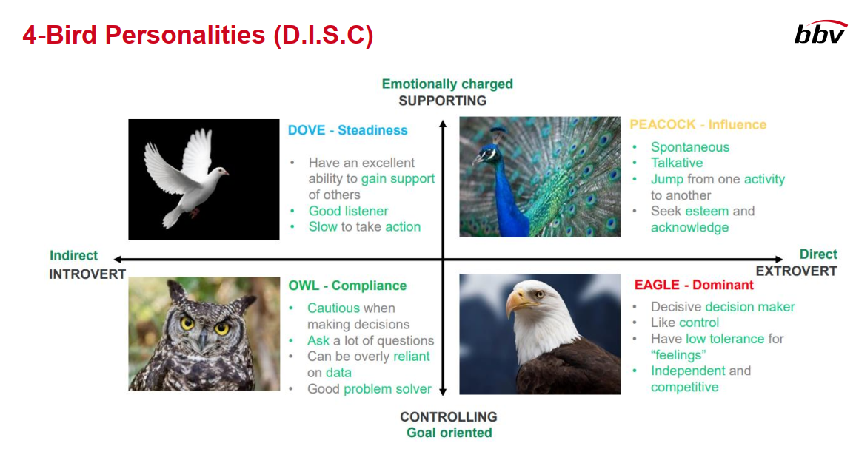
Effective Communication

Slide 13
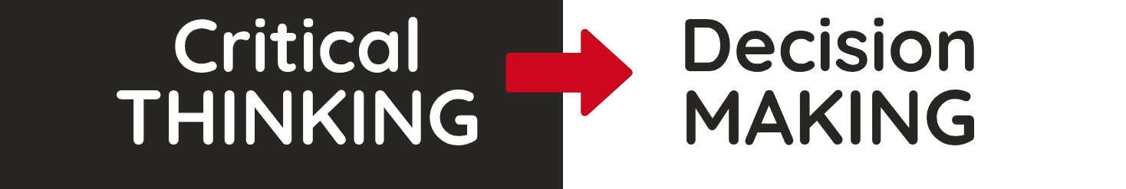
CRITICAL THINKING & DECISION-MAKING SKILLS
Nuongdoan | 24.07.2025

Slide 14
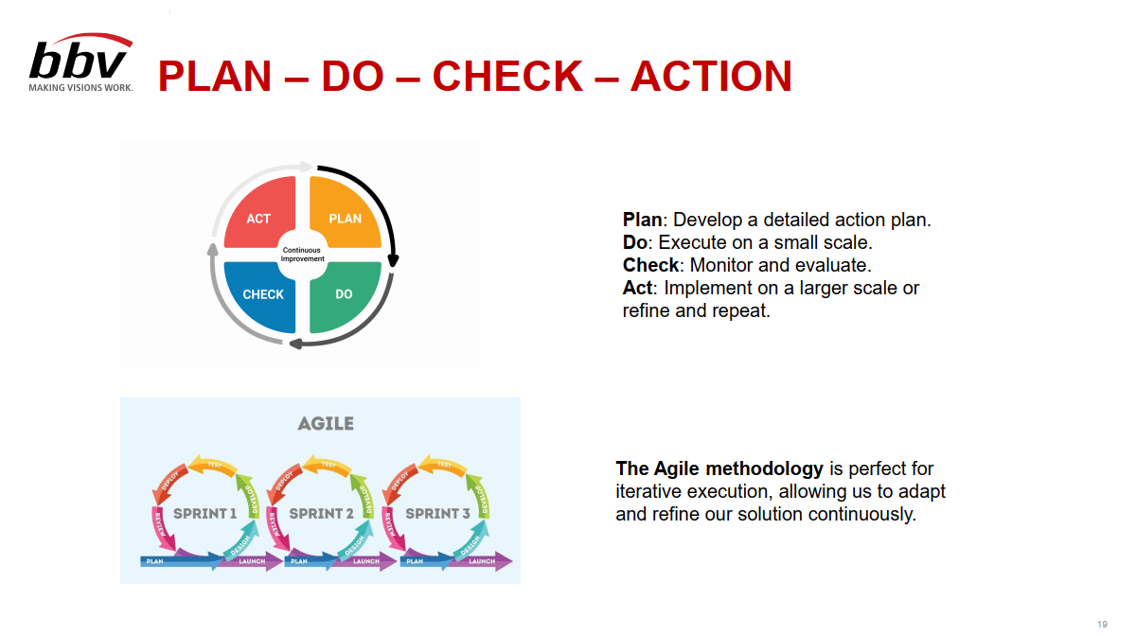
Problem Solving

Slide 15
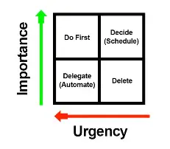
Time management

Slide 16


English Club
This Photo by Unknown Author is licensed under CC BY-NC-ND

Slide 17
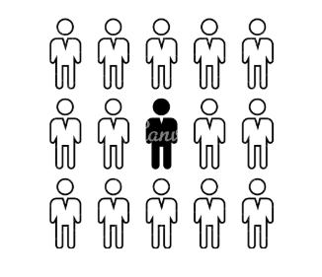

Challenge

Slide 18


Challenge

Slide 19
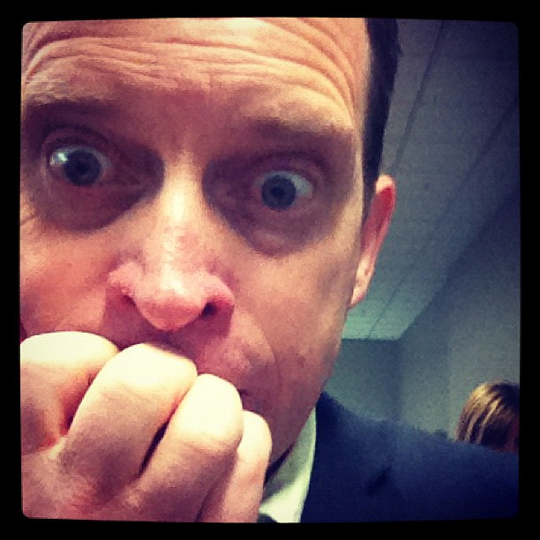

Impact

Slide 20


How to overcome

Slide 21
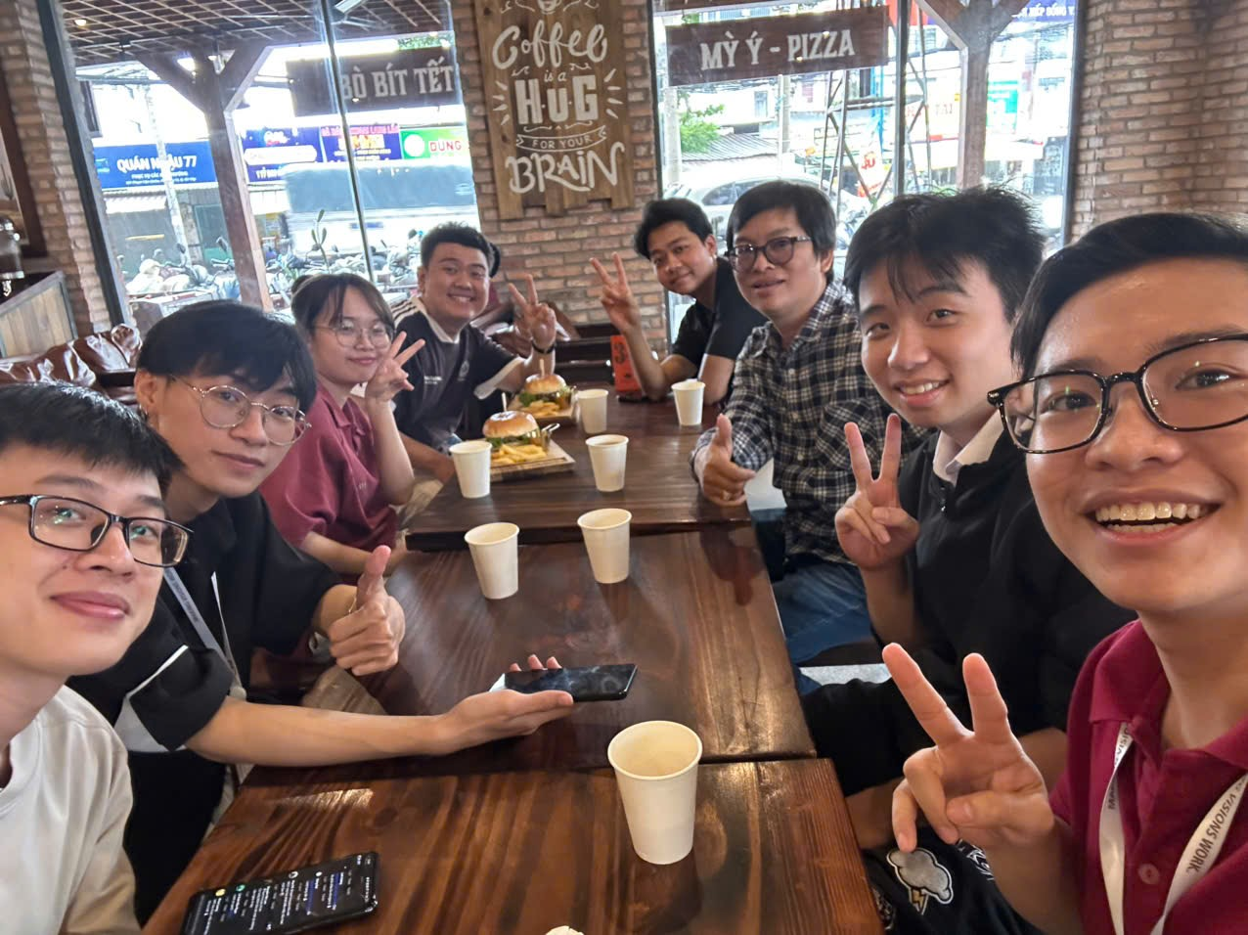
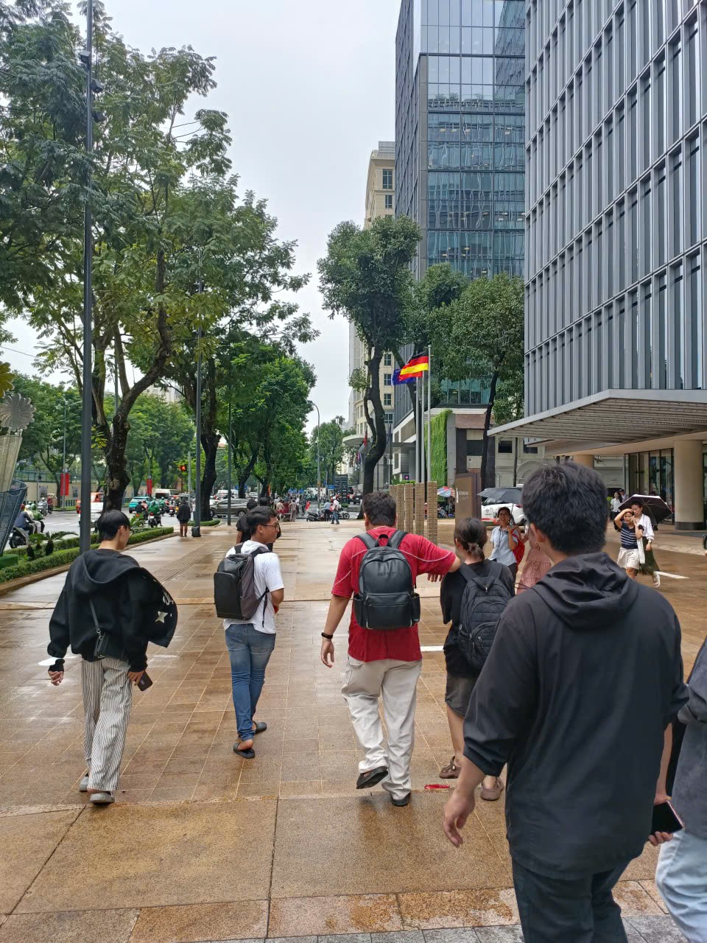
Healing

Slide 22
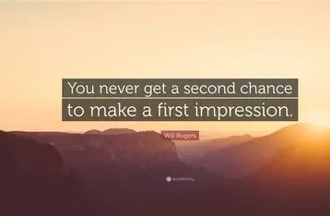
Experience

Slide 23
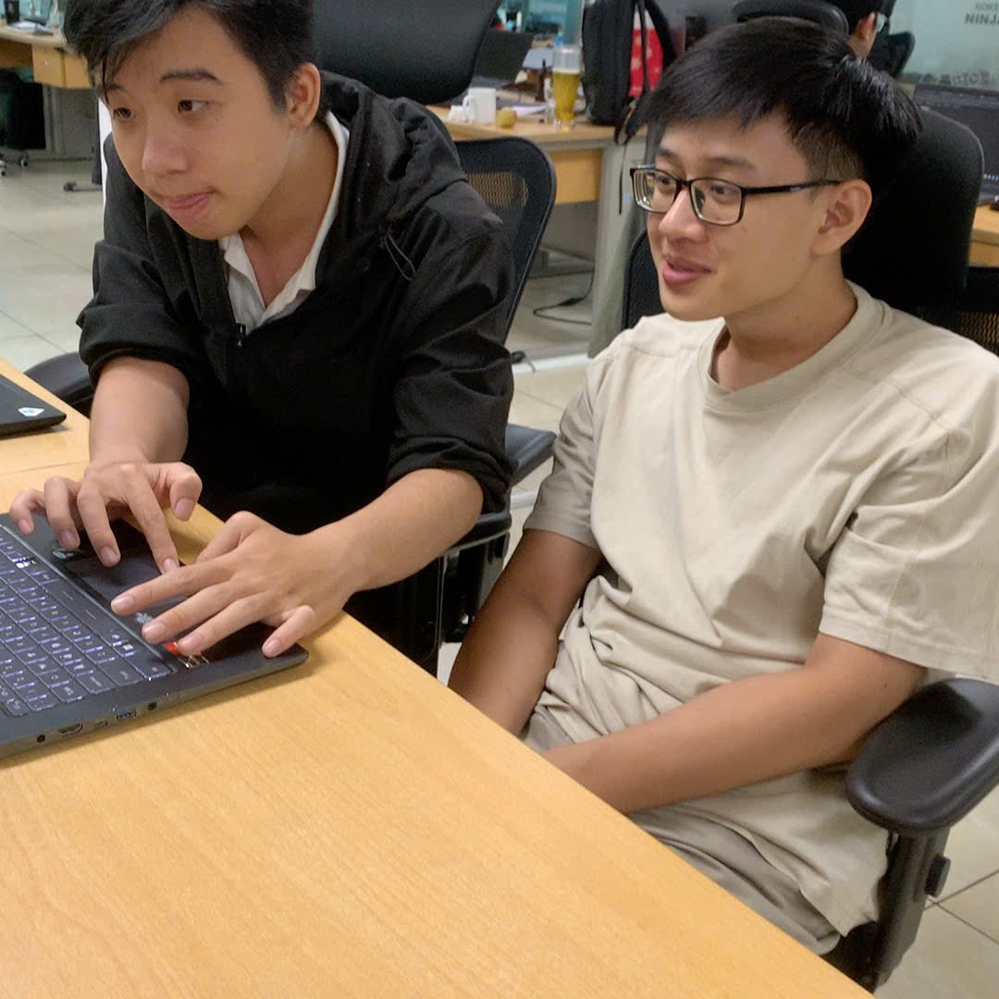
Work & Communicate

Slide 24
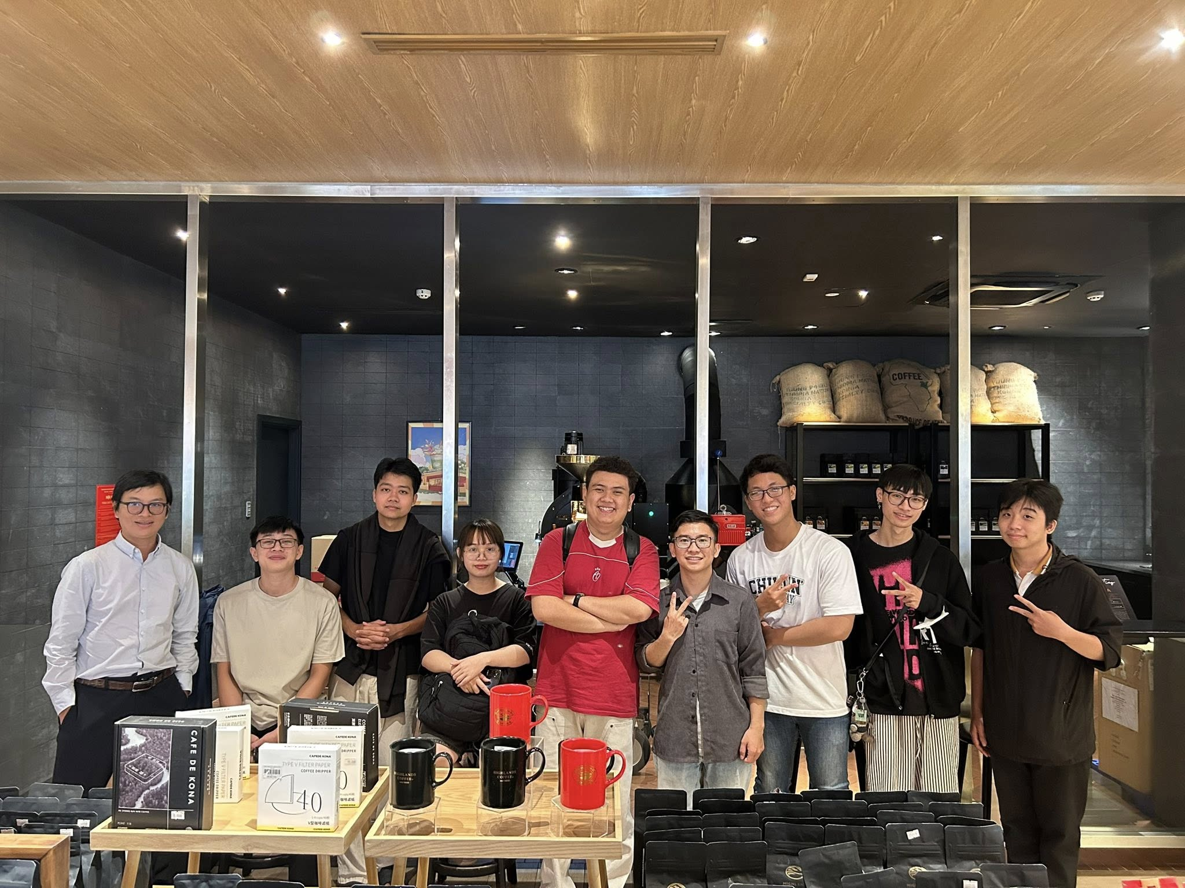
“I’m looking forward to the next milestones to become an even better version of myself.”

Slide 25
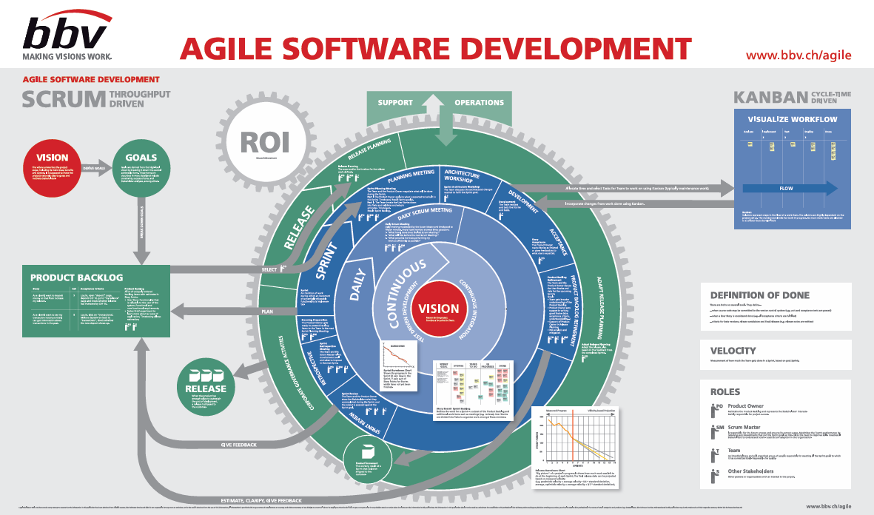

Slide 26
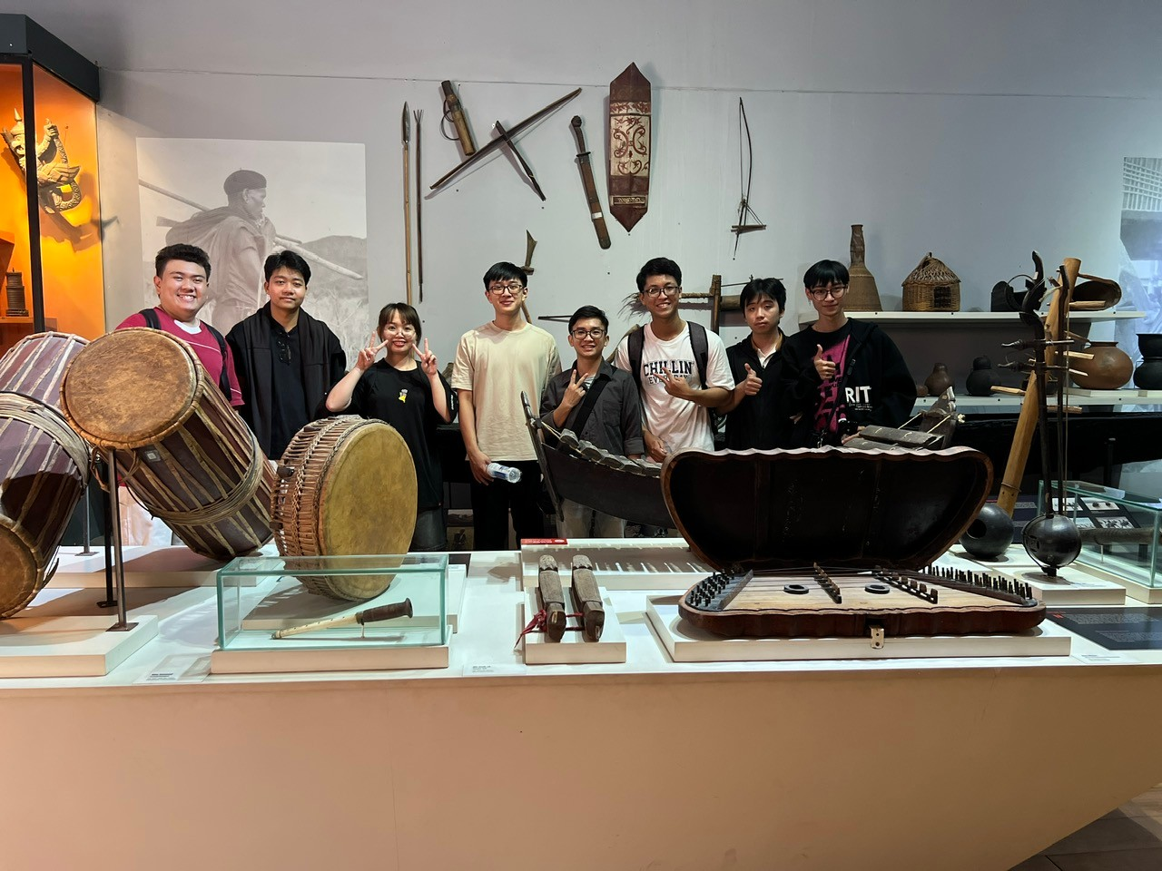
Q&A Thank you
Intern | Khiem Bui

